Slide 1
Android Services

Slide 2
What are Android Services?
Service is the one of the critical application component which can perform long-running operations in the background. It may continue running for time, even user dealing with to another applications. Moreover, main android components can bind to service to interact with it, also you can perform interprocess communication.
Android service is a component that is used to perform operations on the background such as playing music, handle network transactions, interacting content providers etc. It doesn't has any UI (user interface).
The service runs in the background indefinitely even if application is destroyed.
Beware! Services run in the main thread of in hosting process, not create its own thread, so developers should run any blocking operations on the separate thread (manage yourself) for avoiding Application Not Responding (ANR) errors.

Slide 3
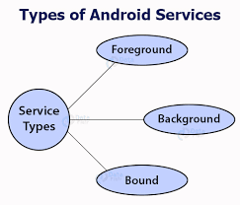
Types of Services

Slide 4
1-Foreground
Type of services that perform operations in the background that is noticeable for the users. This kind of services must display a Notification and It should continue running even user is not dealing with the app. Likewise, Foreground services have own lifecycle that independent from activity or fragment that they were created. Examples of applications that will use foreground services can be listed as follows:
-Music Player App(notification of the current song) -Fitness App(show the distance that user has traveled)

Slide 5
2-Background
Type of services that perform operations in the background that is not giving any information to user via notification. Background services have own lifecycle that independent from activity or fragment that they were created.
Example : Whatsapp checking new messages

Slide 6
3-Bound:
Type of services that offers a client-server interface that allows components(Activity, content provider and service can bind to the Bound service) to interact with the service, send requests, receive results, and even do so across processes with interprocess communication (IPC)
Bound services have no own lifecycle.That’s why, they use the lifecycle of the activity or fragment they were bounded. Moreover, bound services can only run when application component is bounded to it. Likewise, multiple components can bind to service at once, but when all of them unbind, the service is destroyed.

Slide 7
Life Cycle of Android Service
There can be two forms of a service. The lifecycle of service can follow two different paths: started or bound.
Started (Either Foreground or Background)
Bound
1) Started Service
A service is started when component (like activity) calls startService() method, now it runs in the background indefinitely. It is stopped by stopService() method. The service can stop itself by calling the stopSelf() method.
2) Bound Service
A service is bound when another component (e.g. client) calls bindService() method. The client can unbind the service by calling the unbindService() method.
The service cannot be stopped until all clients unbind the service.

Slide 8
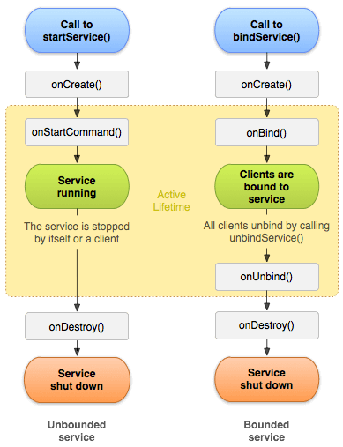

Slide 9
Methods | Description
onStartCommand() | The Android service calls this method when a component(eg: activity) requests to start a service using startService(). Once the service is started, it can be stopped explicitly using stopService() or stopSelf() methods.
onBind() | This method is mandatory to implement in android service and is invoked whenever an application component calls the bindService() method in order to bind itself with a service. User-interface is also provided to communicate with the service effectively by returning an IBinder object. If the binding of service is not required then the method must return null.
onUnbind() | The Android system invokes this method when all the clients get disconnected from a particular service interface.
onRebind() | Once all clients are disconnected from the particular interface of service and there is a need to connect the service with new clients, the system calls this method.
onCreate() | Whenever a service is created either using onStartCommand() or onBind(), the android system calls this method. This method is necessary to perform a one-time-set-up.
onDestroy() | When a service is no longer in use, the system invokes this method just before the service destroys as a final clean up call. Services must implement this method in order to clean up resources like registered listeners, threads, receivers, etc.

Slide 10
